Slide 1

AI Chatbot Tensorflow Seq2seq Model
Machine Learning Lab
Md. Masud Mazumder
Student ID: 19701070
Department of Computer Science and Engineering
University of Chittagong
Instructor:
Nasrin Sultana (Assistant Professor)
Department of Computer Science and Engineering
University of Chittagong

Slide 2


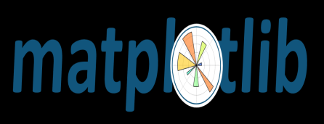

Table of Content:
Introduction
Data collection and preprocessing
Building the model:
LSTM Architecture
Encoder Decoder model
Word embedding for encoder and decoder
Attention mechanism
Greedy Embedding helper
Optimization
Evaluation metrics comparison
Testing the model
Model Parameters optimization
Future Improvement
Conclusion

Slide 3
Introduction:
Conversational AI Chatbot is a language recognition system able to maintain a conversation with a user using a question/answer protocol.
We are going to focus on the textual models.
Many major tech companies are using a virtual assistant or chat agent to fill the needs of customers.
Some of them include Google’s Google Assistant, Microsoft’s Cortana and Amazon’s Alexa.

Slide 4

A sequence is an ordered list of symbols. For Ex:
A sequence of webpages visited by a user, ordered by the time of access.
A sequence of words or characters typed on a cellphone by a user, or in a text such as a book.
A sequence of products bought by a customer in a retail store
A sequence of proteins in bioinformatics
A sequence of symptoms observed on a patient at a hospital
The task of sequence prediction consists of predicting the next symbol of a sequence based on the previously observed symbols. For example, if a user has visited some webpages A, B, C, in that order, one may want to predict what is the next webpage that will be visited by that user to prefetch the webpage.
Source: http://data-mining.philippe-fournier-viger.com

Slide 5
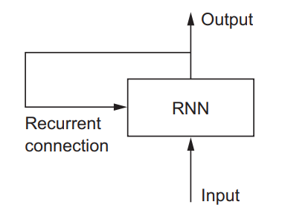
RNN:
Recurrent Neural Networks, or RNNs, were designed to work with sequence prediction problems.
Recurrent means the output at the current time step becomes the input to the next time step. At each element of the sequence, the model considers not just the current input, but what it remembers about the preceding elements.
Why RNN?
To maintain word order
To share parameters across the sequence

Slide 6
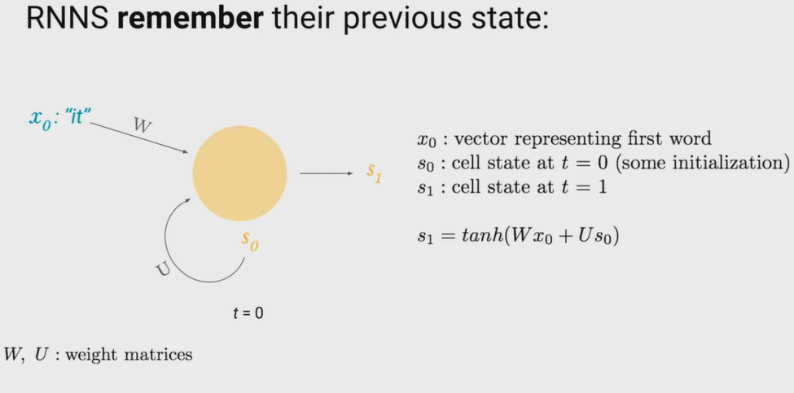

Slide 7
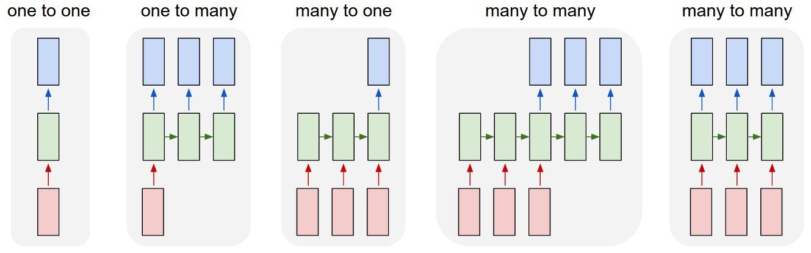
Types of RNN:
One-to-Many: An observation as input mapped to a sequence with multiple steps as an output.ex:image(i/p) description (o/p)
Many-to-One: A sequence of multiple steps as input mapped to class or quantity prediction. Ex: Language classification
Many-to-Many: A sequence of multiple steps as input mapped to a sequence with multiple steps as output.ex:Machine translation

Slide 8
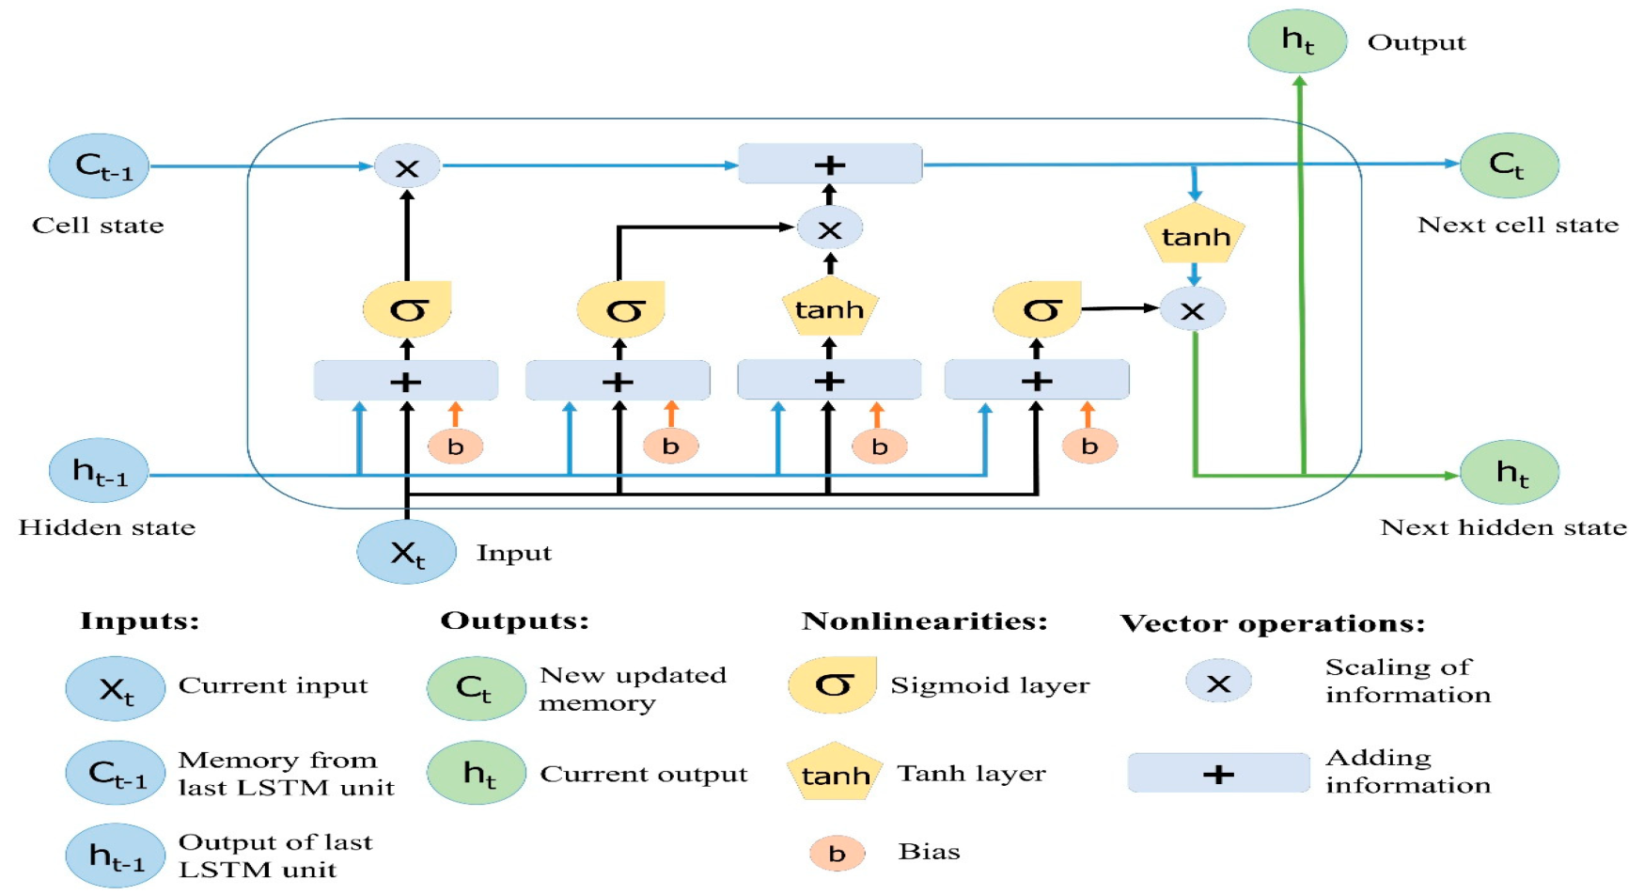
LSTM:
Long Short-Term Memory (LSTM) networks are a type of recurrent neural network capable of learning order dependence(long-term dependencies) in sequence prediction problems.
This is a behavior required in complex problem domains like machine translation, speech recognition, and more.
Image Source: https://colah.github.io

Slide 9
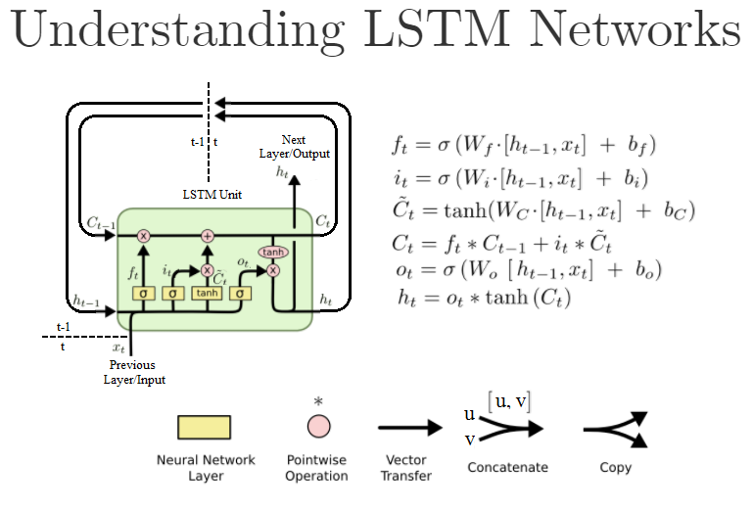
Image Source: https://colah.github.io

Slide 10
Seq2Seq LSTMs or RNN Encoder-Decoders:
An “encoder” RNN reads the source sentence and transforms it into a rich fixed-length vector representation, which in turn is used as the initial hidden state of a “decoder” RNN that generates the target sentence. Here, we propose to follow this elegant recipe, replacing the encoder RNN by a deep convolution neural network (CNN). … it is natural to use a CNN as an image “encoder”, by first pre-training it for an image classification task and using the last hidden layer as an input to the RNN decoder that generates sentences.
… an RNN Encoder–Decoder, consists of two recurrent neural networks (RNN) that act as an encoder and a decoder pair. The encoder maps a variable-length source sequence to a fixed-length vector, and the decoder maps the vector representation back to a variable-length target sequence.

Slide 11
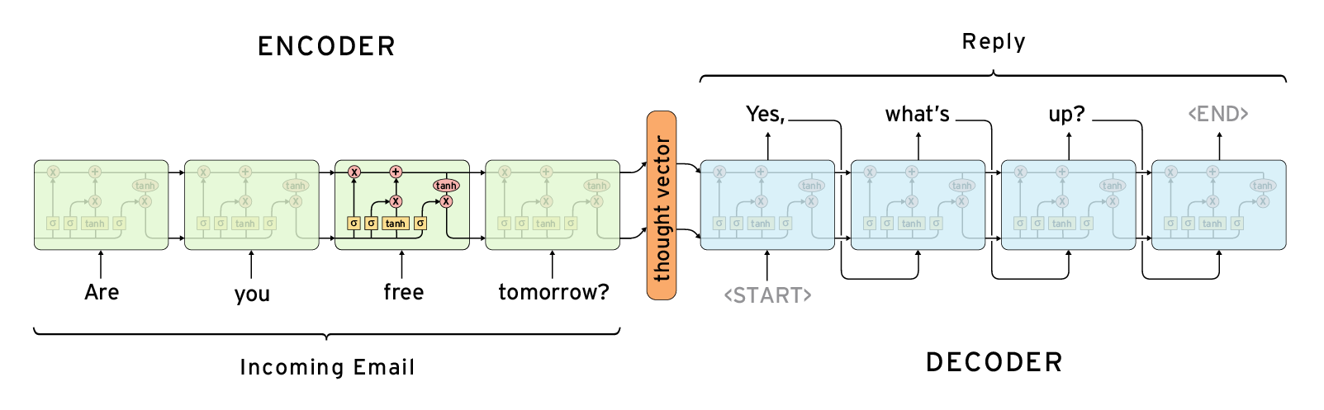
Example architecture of Seq2Seq LSTMs or RNN Encoder-Decoders

Slide 12
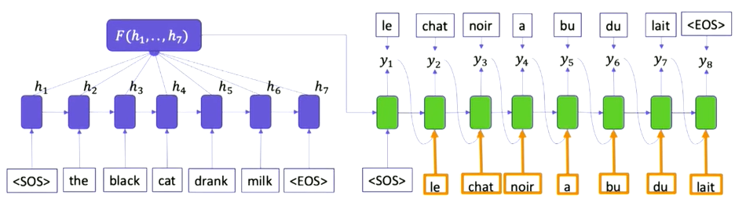
Machine Translation Example:

Slide 13
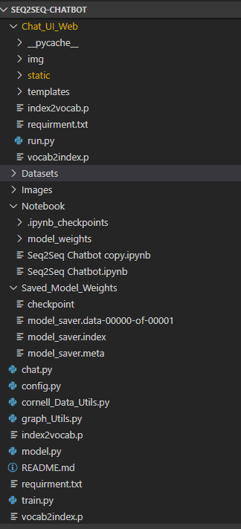
Undersatanding Working Directory:

Slide 14
Dataset : Cornell Movie Dialogs Corpus
Description:
This corpus contains a large metadata-rich collection of fictional conversations extracted from raw movie scripts.
Link to download dataset : https://www.cs.cornell.edu/~cristian/Cornell_Movie-Dialogs_Corpus.html
https://www.kaggle.com/rajathmc/cornell-moviedialog-corpus
220,579 conversational exchanges between 10,292 pairs of movie characters
Involves 9,035 characters from 617 movies
In total 304,713 utterances
Movie metadata included:
Genres
Release year
IMDB rating
Number of IMDB votes
Character metadata included:
Gender (for 3,774 characters)
Position on movie credits (3,321 characters)
README.txt (included) for details

Slide 15
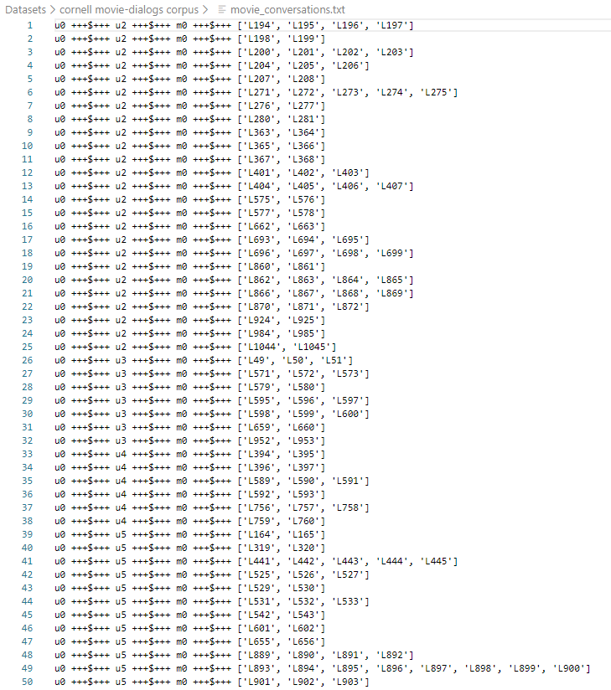
Movie Conversation File:
First 50 lines of movie_conversations.txt:

Slide 16
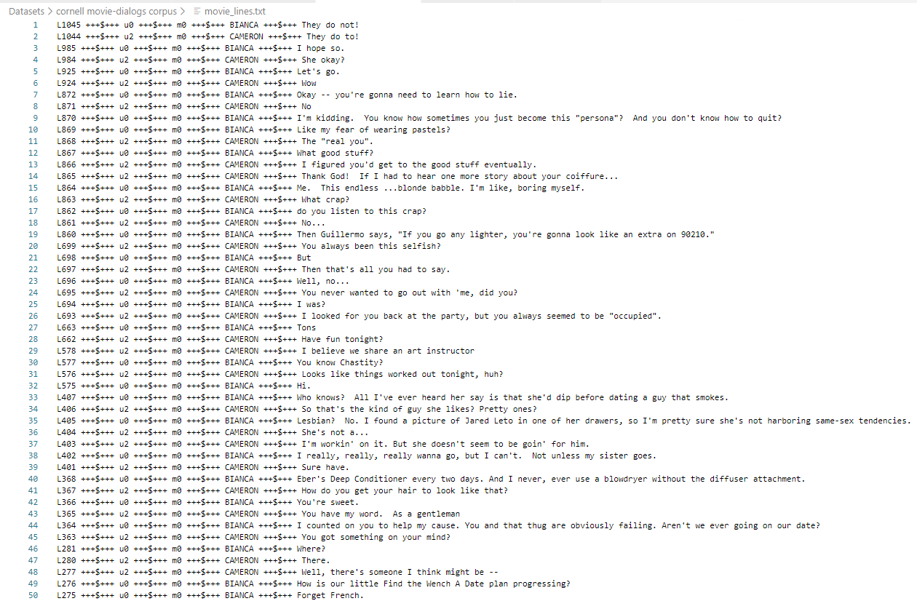
Movie Lines File:
First 50 lines of movie_lines.txt:

Slide 17


Understanding Single Conversation:
Take first conversation in movie_conversations.txt
i.e ['L194', 'L195', 'L196', 'L197']
Corresponding movie lines(index and line) for the above conversation:

Slide 18
Preprocessing I:
Step 1:
Read from 'movie_conversations.txt'
Create a list of [list of line_id's]
Output Ex: ['L194', 'L195', 'L196', 'L197']
Step 2:
Read from 'movie-lines.txt'
Create a dictionary with ( key = line_id, value = text )
Ex:
They do not!
They do to!
I hope so.
She okay?
Let's go.
Wow
Okay -- you're gonna need to learn how to lie.
No
I'm kidding. You know how sometimes you just become this "persona"? And you don't know how to quit?
Like my fear of wearing pastels?
The "real you".
What good stuff?
I figured you'd get to the good stuff eventually.

Slide 19
Preprocessing II:
Step 3:
Get lists of all conversations as Questions and Answers
[questions]
[answers]
Question and answers are come from same conversation. As because there will be a question with the response.
Ex: For our first conversation
Q Can we make this quick? Roxanne Korrine and Andrew Barrett are having an incredibly horrendous public break- up on the quad. Again.
A Well, I thought we'd start with pronunciation, if that's okay with you.
Q Well, I thought we'd start with pronunciation, if that's okay with you.
A Not the hacking and gagging and spitting part. Please.
Step 4:
Clean Text:
Text to lowercase
Replacing certain words as follow:
Ex:
text = re.sub(r"i'm", "i am", text)
text = re.sub(r"he's", "he is", text)

Slide 20
Preprocessing III:
Step 5:
Filter out the Questions and Answers that are too short/long. Minimum & Maximum length are 2 & 5.
Step 6:
Get each word and its count from filtered questions and answers in vocab dictionary. Get each word and its count from filtered questions and answers in Question and Answer vocab dictionary
Step 7:
Create vocabulary index with total number of words appear more than 2 times in vocab dictionary
6281 words which appear more appear more than 2 times
Step 8:
For each codes(<EOS>,<PAD>,<UNK><GO>) ,increment vocabulary index to 1 for each existing code. Same for question and answer vocab.
Now vocab index will be 6285
Step 9:
Create index vocabulary from vocabulary index dictionary
index vocabulary dict_items([(0, 'what'), (1, 'good'), (2, 'stuff'), (3, 'she'), (4, 'okay'), (5, 'they'),............., (6283, '<PAD>'), (6284, '<EOS>'), (6285, '<UNK>'), (6286, '<GO>')])
Step 10:
Add EOS tag at the end of each answer
Ex: the real you → the real you <EOS>

Slide 21
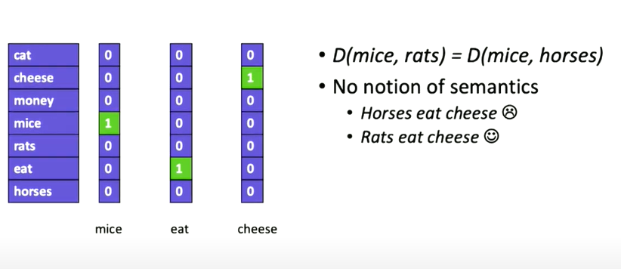
Word Representation: One-hot
No semantic meaning

Slide 22
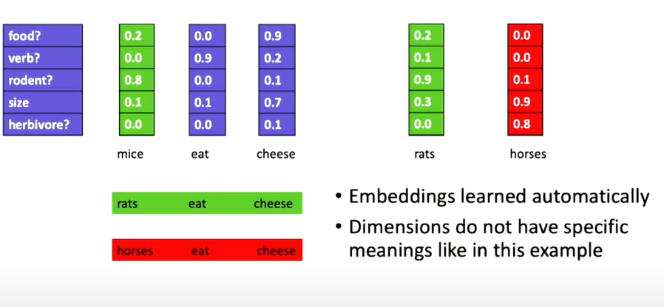
Word Embeddings
Enable semantics.
Measures distance between words in semantic space

Slide 23
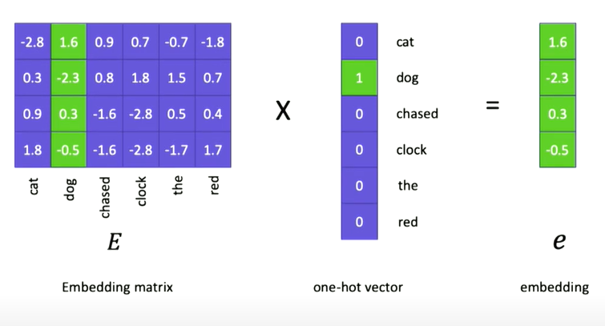
From one-hot to Embeddings
Embadding matrix is a learned parameters of the model. Embedding vector for the particular word

Slide 24
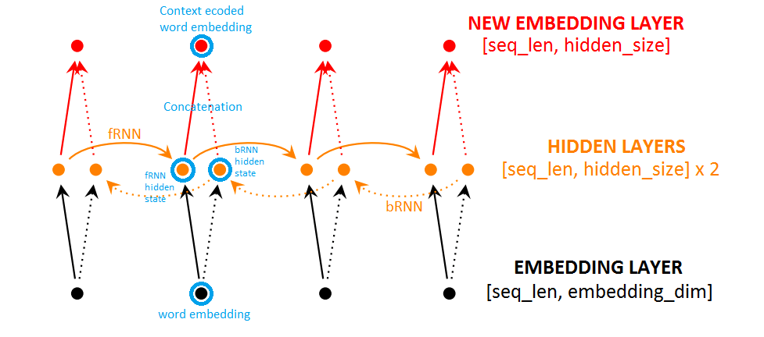
Bidirectional RNN
Bidirectional Recurrent Neural Networks (BRNN) connect two hidden layers of opposite directions to the same output. With this form of generative deep learning, the output layer can get information from past (backwards) and future (forward) states simultaneously.

Slide 25
Attention Mechanism:
Freeing the encoder-decoder architecture from the fixed-length internal representation.
Achieved by keeping the intermediate outputs from the encoder LSTM from each step of the input sequence and training the model to learn to pay selective attention to these inputs and relate them to items in the output sequence.
Each time the proposed model generates a word in a translation, it (soft-)searches for a set of positions in a source sentence where the most relevant information is concentrated. The model then predicts a target word based on the context vectors associated with these source positions and all the previous generated target words.
… it encodes the input sentence into a sequence of vectors and chooses a subset of these vectors adaptively while decoding the translation. This frees a neural translation model from having to squash all the information of a source sentence, regardless of its length, into a fixed-length vector.

Slide 26
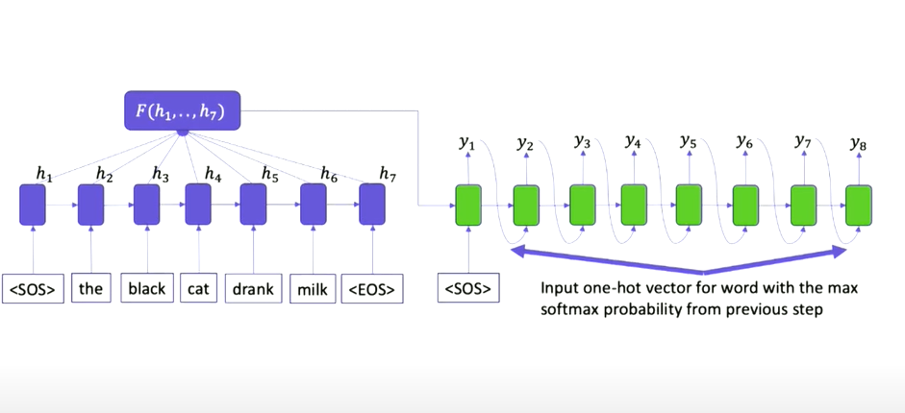
Encoder-Decoder model:

Slide 27
Optimizer: Adam Optimizer
The method computes individual adaptive learning rates for different parameters.
Adam as combining the advantages of two other extensions of stochastic gradient descent.
Adaptive Gradient Algorithm (AdaGrad) that maintains a per-parameter learning rate that improves performance on problems with sparse gradients (e.g. natural language and computer vision problems).
Root Mean Square Propagation (RMSProp) that also maintains per-parameter learning rates that are adapted based on the average of recent magnitudes of the gradients for the weight (e.g. how quickly it is changing). This means the algorithm does well on online and non-stationary problems (e.g. noisy).

Slide 28
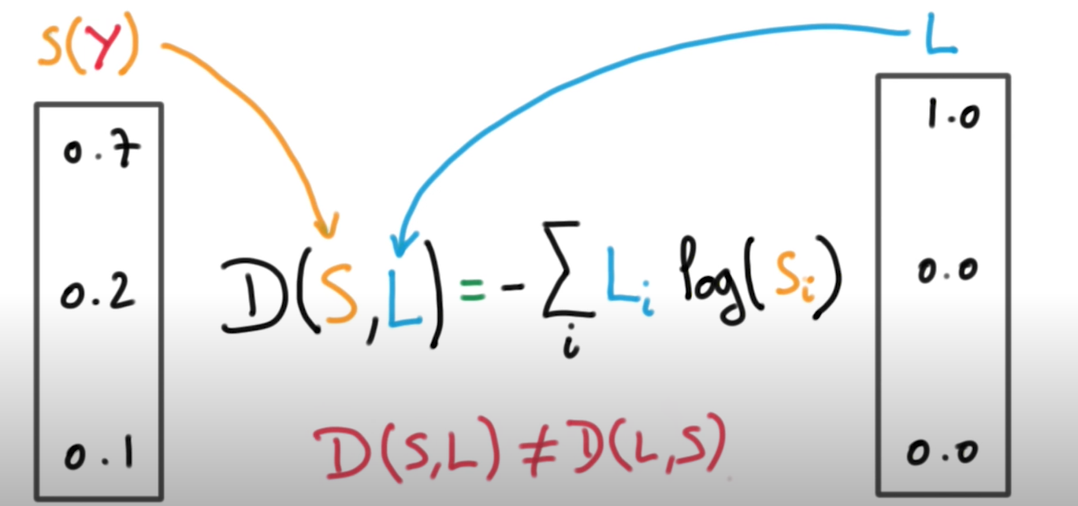
Loss:
Weighted cross-entropy loss for a sequence of logits.

Slide 29
Configuration:
Config 1
Config 2
batch_size = 128
rnn_size = 128
embed_size = 128
learning_rate = 0.001
keep_prob = 0.75
epochs = 500
model_dir = 'saved_model_weights'
save_path = 'model_saver'
min_learning_rate = 0.0001
learning_rate_decay = 0.9
batch_size = 512
rnn_size = 512
embed_size = 512
learning_rate = 0.001
keep_prob = 0.75
epochs = 80
model_dir = saved_model_weights
save_path = 'model_saver'
min_learning_rate = 0.0001
learning_rate_decay = 0.9

Slide 30
Execution Time:
For Config 1:
For each epochs it took nearly 2 to 3 mins as we do have 500 epochs it took nearly 1000 mins that’s 16.5 hours in local machine(CPU).
For Config 1:
For each epochs it took nearly 8 to 9 mins as we do have 80 epochs it took nearly 900 mins that’s 15 hours in Google Colab Platform(CPU).

Slide 31
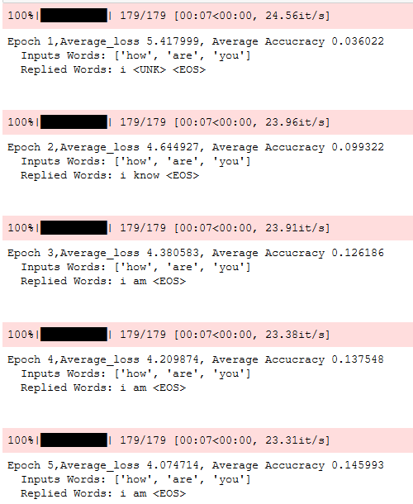
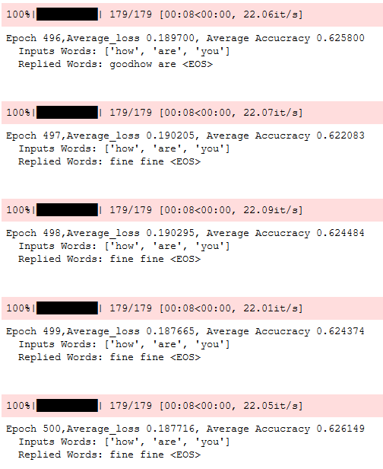
Config 1
Initial Epochs:
Final Epochs:

Slide 32
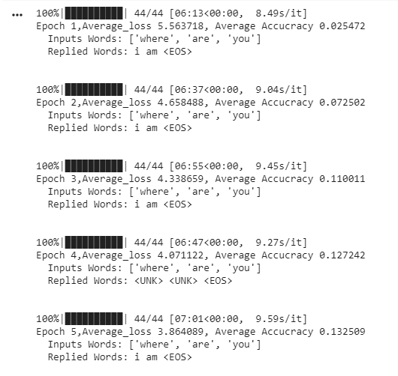
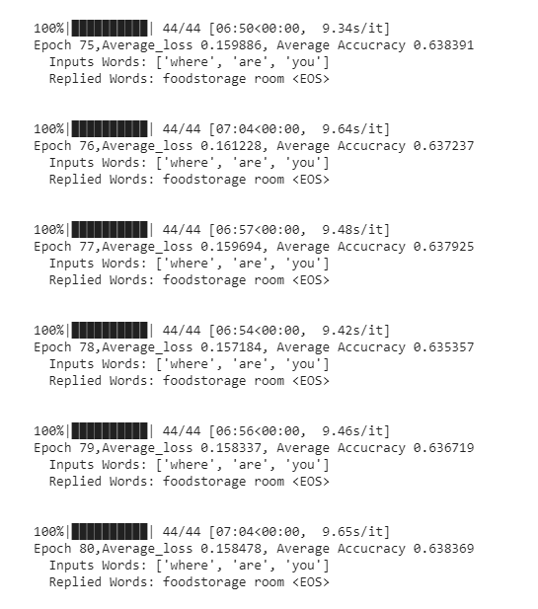
Config 2
Initial Epochs:
Final Epochs:

Slide 33
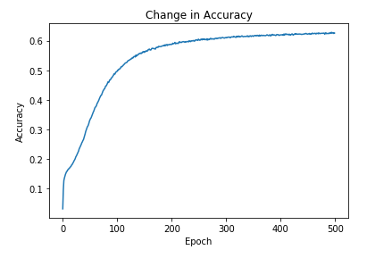
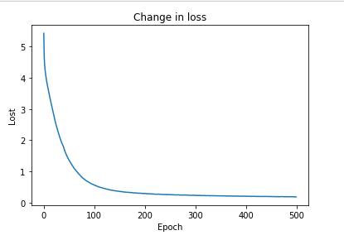
Config 1
Accuracy Plot:
Loss Plot:

Slide 34
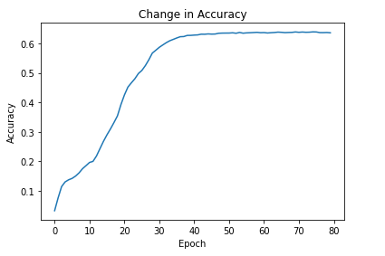
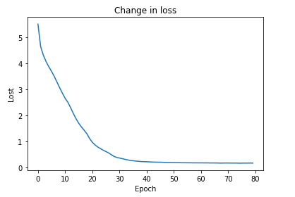
Config 2
Accuracy Plot:
Loss Plot:

Slide 35
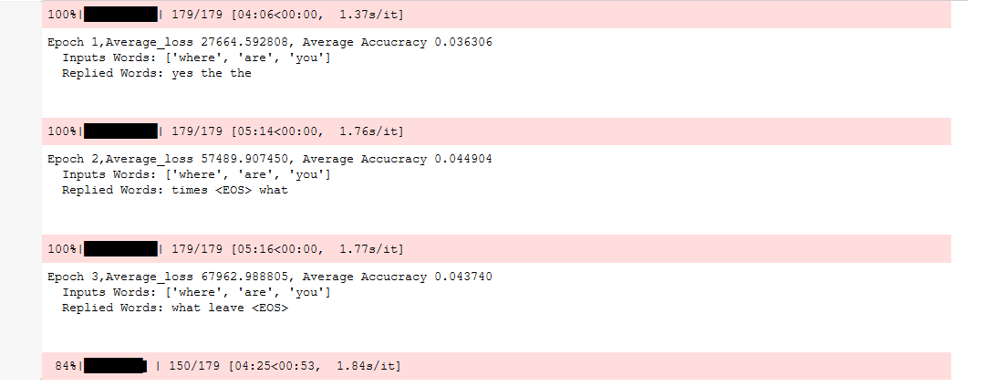
Initial Epochs with Learning Rate=0.5 in Config 1

Slide 36
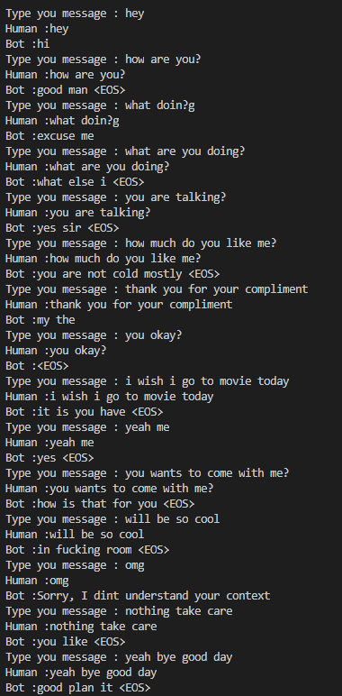
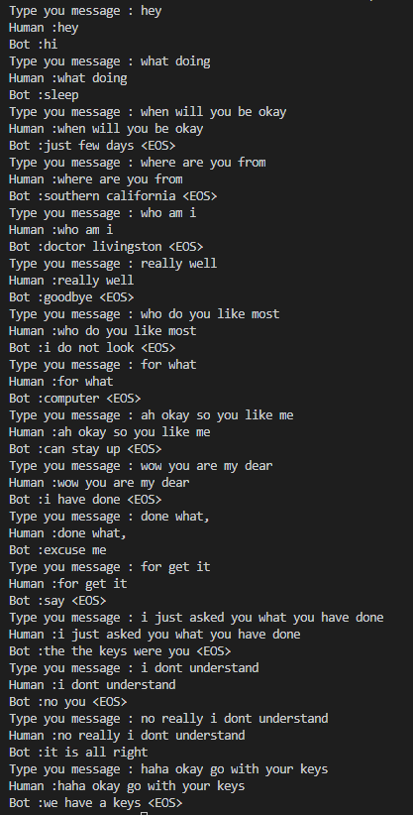
Test:

Slide 37
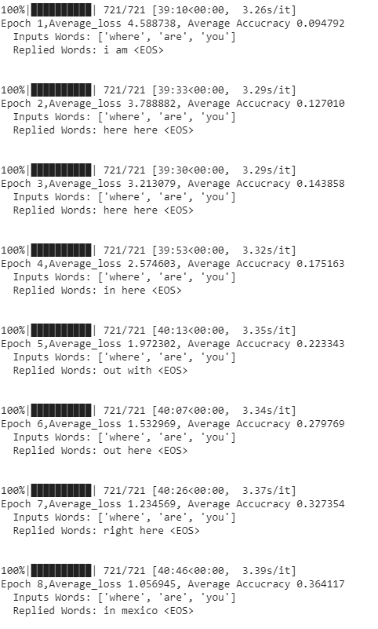
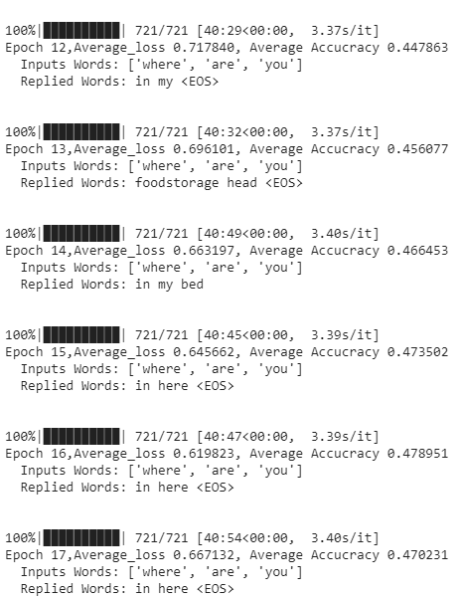
Config 3:

Slide 38
Web Interface
Flask app that provides a chat interface to the user, to interact with our seq2seq model.
The reply method in the code is called via an AJAX request from index.js.
It sends the text from user to our seq2seq model, which returns a reply.
The reply is passed to index.js and rendered as text in the chatbox.

Slide 39
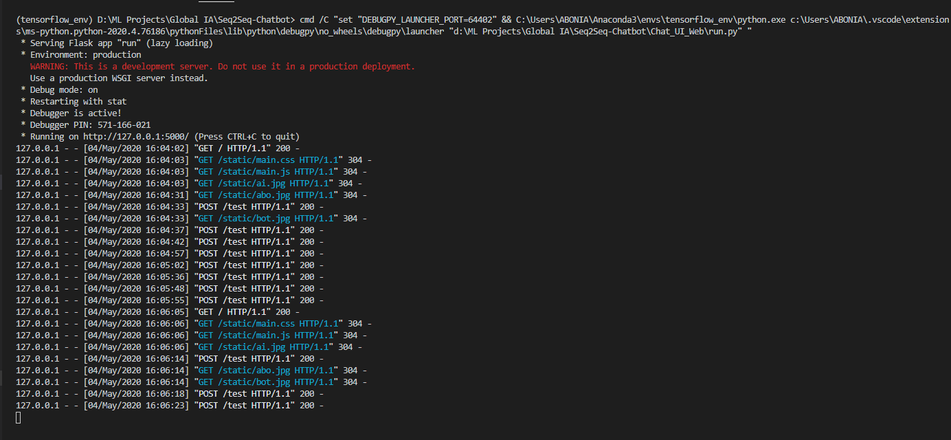
Run a web App with Flask:

Slide 40
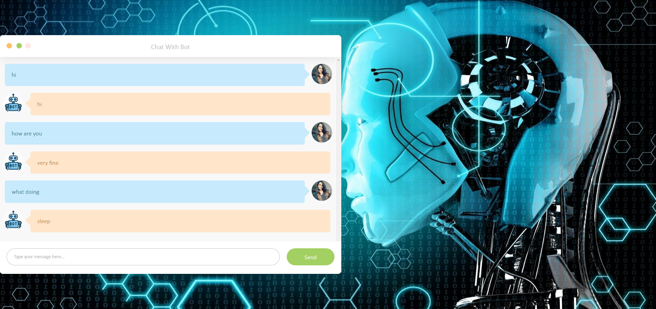
UI

Slide 41
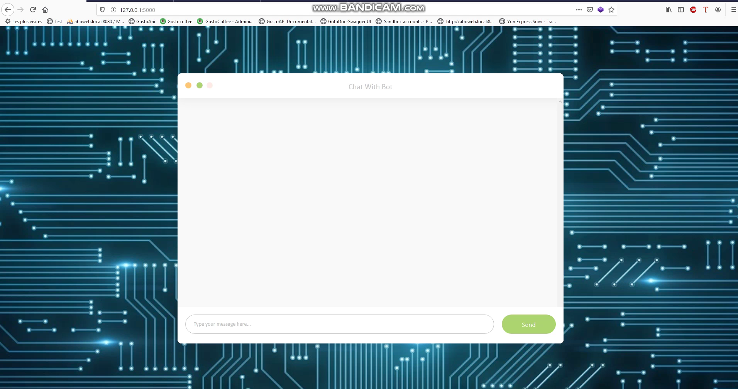

Slide 42
Future work:
Use attention mechanism like luong attention
Beam Search algorithm
Optimize based on other metrics
Embedding size and batch size to 1024(computationaly expensive)
Learning rate to 0.001 and dropout ratio to 0.5

Slide 43
Conclusion:
The training data on Cornell Movie Subtitle corpus produced a result that needs further improvement and more attention and speculation on training parameters.
Adding more quality data will further improve performance.
Also, the training model should be trained with other hyper-parameters and different datasets for further experimentation.

Slide 44
